Slide 1
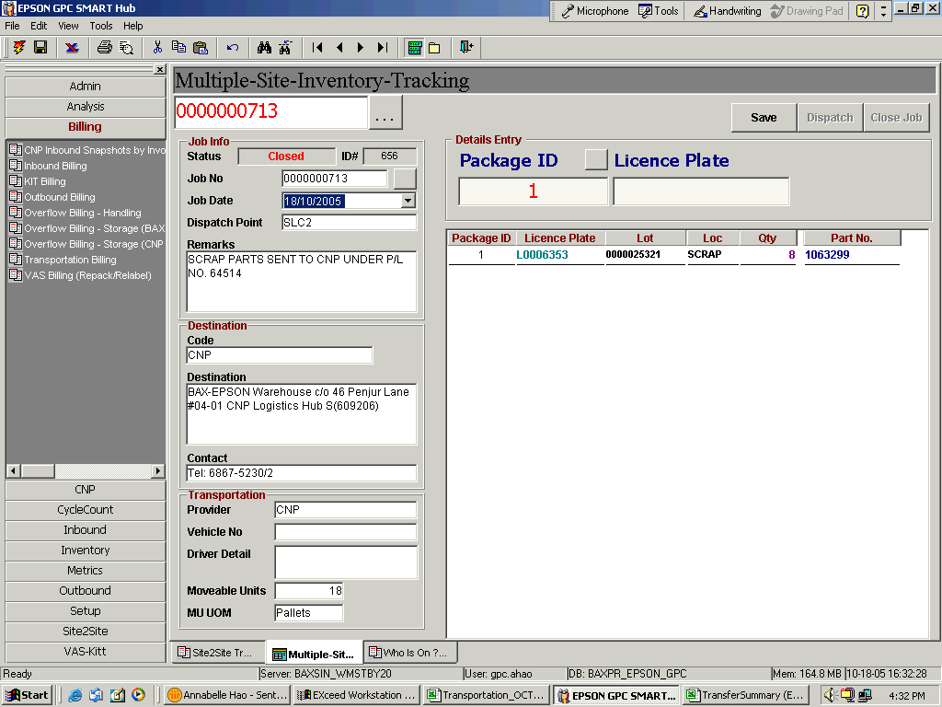
Add JOB TYPE allow user to choose and enable the job to be CLOSED without inputting any details entry i.e PACKAGE/ LP information for actual move.
2. If SCRAP/Others job type selected, system will allow closure of the JOB without dispatch. No PACKAGE/ LP INFORMATION should entered to the Details.
3. If Job Type = NORMAL, it will follow usual transfer procedure.

